Slide 1
COLLEGE TRANSPORT MANAGEMENT SYSTEM
GROUP MEMBERS:-
MD MIRAJ ANSARI (1AY18MCA14)
THEJASHWINI CR (1AY18MCA31)
LAVANYA TL (1AY18MCA13)
TABASSUM KHANUM (1AY18MCA30)

Slide 2
INTRODUCTION
This is a web-related application that permits us to approach the entire knowledge
regarding the College Transport Management, employees, students, faculties etc.
This application is also called as College Transport Management System.
Following are the modules that we have worked on:
Registration Process
Student Info
Faculty Info
Account Info
Admin

Slide 3
OBJECTIVE
The main objective of this system is to reduce the consumption of time during maintaining the records of college Transport management. Separate divisions are provide to maintain the records of Student, faculty, Roots, diversion, etc.
In other words the objective of the present college Transport management software are:
Simple database is maintained.
Easy operation for the operator of the System.
Faster execution & maintaining the records.
User interface are user friendly and attractive, it takes very less time for the operator to get use-to with the system.

Slide 4
The system COLLEGE TRANSPORT MANAGEMENT SYSTEM can be used to manage the data of all type of TRANSPORT MANAGEMENT. It will support both stand alone and also networking environment. The system uses WEB Technology.
The main modules involved in this system are:
Login
Forms
Reports
Announcement

Slide 5
Login
Login module is used to check whether the user is an authorized person to use the system or not. For this the user should give the correct user name and password.
The different types of users are
Admin
Account
Student
Employee/Faculty
Forms
This module consists of the following sub modules
Student/Faculty Registration Form
Student/Faculty ID Form
Student/Faculty Detail Form
Account Detail Form

Slide 6
MODULE DESCRIPTION
Administrator Module
User module
Administrator Module:
This module provides administrator related functionality. Administrator can add ,delete ,update and view details of vehicles,routes. The administrator maintain the details of employees who avail the transportation service.
User Module
User can view all information about the route like time details,stop details and can make complaint for the service and view the status about the complaint.User give feedback about the service.

Slide 7
PROBLEM STATEMENT
Today all the work at the time of taking transport services of the students is done manually by ink and paper, which is very slow and consuming much efforts and time.
Since the numbers of students is growing, and management has to handle records of all the student it is facing a little bit problems in maintaining the records of students and other details.
It is required to Design of a Computerized College Transport Management System, to speed up and make it easy to use system.

Slide 8
SYSTEM REQUIREMENTS
Hardware Requirements:-
In order to run the project system needs to have following minimum hardware
configuration:-
RAM: 256 MB.
Processor: Pentium III.
Software/Operating System:-
Windows XP, Windows Vista, Windows 2000.
Technology Used:-
Notepad++
Front End:-html,php,css,javascript
Back End:-mysql.

Slide 9
Proposed System
In our proposed system we have the provision for adding the details of the students. Another advantage of the system is that it is very easy to edit the details of the student and delete a student when it found unnecessary. Here is facility of find root, direction, individual profile facility is also provided. Online updating and changes is possible.
By developing the system, we can attain the following facilities:
Easy to handle and feasible.
Easy to operate.
Cost reduction.
Fast and convenient.

Slide 10
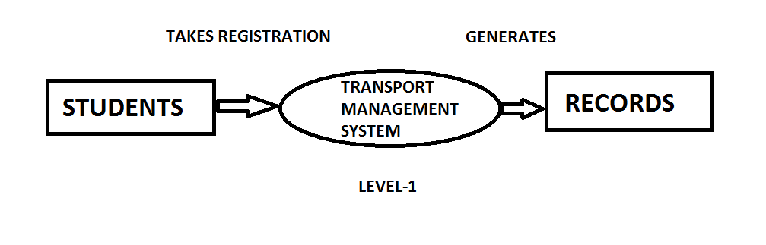
DATA FLOW DIAGRAM

Slide 11
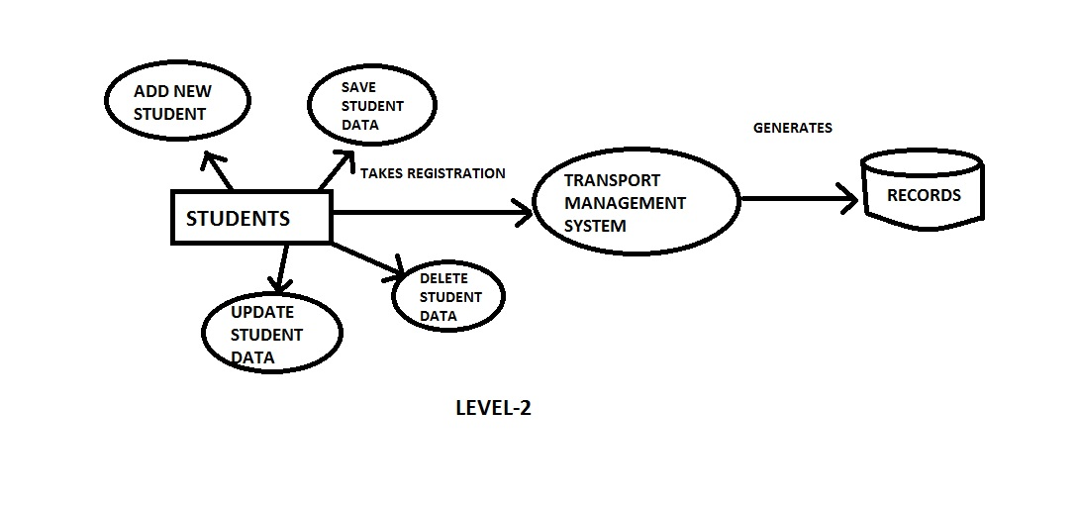
DATA FLOW DIAGRAM

Slide 12
THANK YOU

